Slide 1
Medical Prescription Generator using Artificial Intelligence
Project Proposal Presentation
by
Ayushree Chakrabartty(2147141)
Divya V. Prasad(2147145)
Priyanka Yadav (2147150)
Project Guide
Dr. V THIRUNAVUKKARASU
Department of Computer Science
CHRIST(Deemed to be University), Bengaluru-29

Slide 2
AGENDA
Introduction
Existing System
Limitations of Existing System
Proposed System
Functional Description
Solution Architecture
Block Diagram
Software & Hardware Requirements
Benefits of Proposed System
Plan of Work
Future Enhancements
References

Slide 3

1. Introduction
Optical Character Recognition (OCR)
AI-backed tool
allows the software to interpret text on scanned images and extract their data.

Slide 4

2. Existing System
Manually handling the medical prescription written by doctors.
NLP engines like MedLee, MetaMap

Slide 5
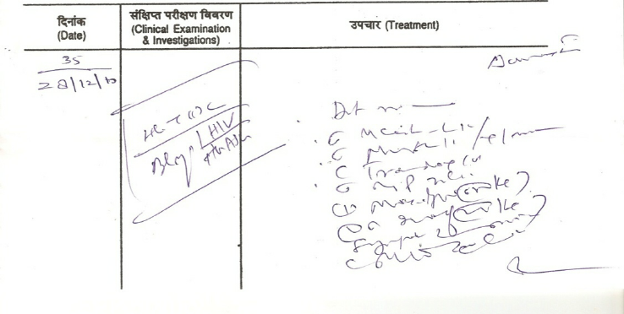
3. Limitations to Existing System
causes inconvenience to patients as well as doctors
takes time
unreadability of prescription
various human errors

Slide 6
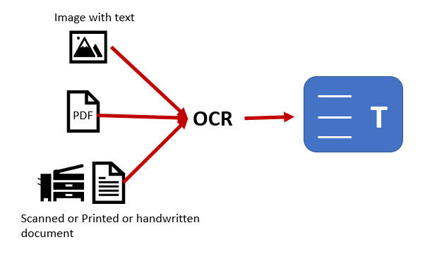
4. Proposed System
automate the process, eliminates manual entry
ensures accuracy with voice based entry
all actions are logged into database for further analysis
efficiency, confidentiality in patient’s report
Conditional Random Fields with word embedding
relationship extraction

Slide 7
5. Functional Description
Doctor should be able to register/log in to the system
System should be able to collect and store data entered by doctor
System should be able to perform authentication of doctors
Successful authentication allows doctor to record voice
System should be able to convert voice to text using Speech Recognition API
System should be able to send text to Named Entity Recognition Model
Preprocessing task like Tokenization , filtering , etc are done

Slide 8
System should be able to extract needful information like drug name, dosage, symptoms, duration, etc is done
The model output is then sent back to the application in JSON format.
A medical prescription is generated using the model output.
The prescription is re-verified by doctor and sent to patient via email.
‹#›

Slide 9
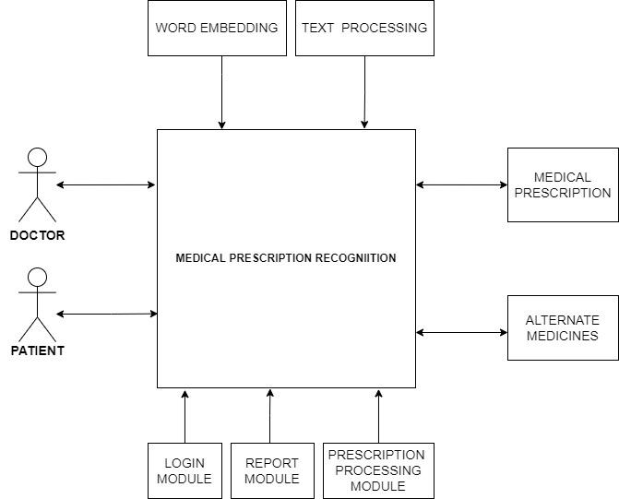
6. Solution Architecture

Slide 10
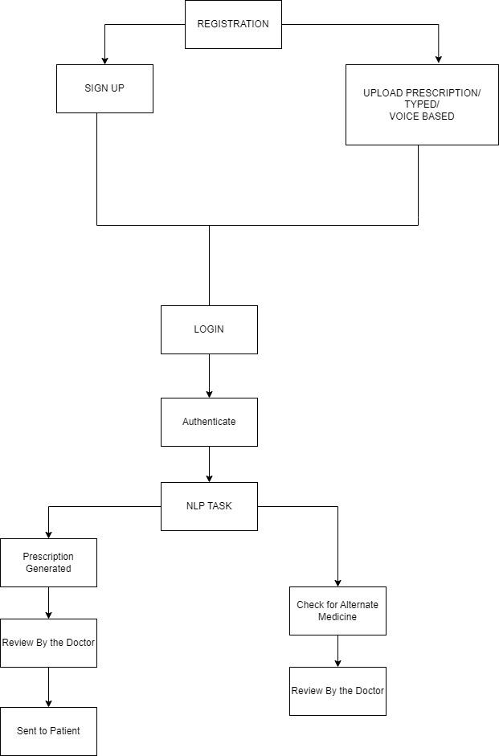
7. Block Diagram

Slide 11
8. Software and Hardware Requirements
Software Requirements :
Operating System - Certified Distribution of WINDOWS
Visual Studio
Web Browser - Google Chrome
Database(Backend) - SQL
Python 3.6 - nltk, pytorch, scispacy
Hardware Requirements :
Processor: Intel Core i5 8th Gen
RAM: 16 GB
Hard Disk: 1 TB

Slide 12
9. Benefits of the Proposed System
It will give good readability to pharmacists as well as people with no medical background in cases of emergency.
The efficiency of the doctor is improved as there is shift of burden regarding the unreadability .
The system would also recommend alternative medicines in case of unavailability of a particular medicine.
This will reduce the manual work and all the medical history and prescription will be saved in digitialized format.

Slide 13
10. Plan of Work
Week → | 1 | 2 - 3 | 4 - 5 | 6 - 8 | 9 - 10 | 11 - 12
Planning
Defining
Designing
Building
Testing
Deployment

Slide 14
11. Future Enhancement
implementation of medicine recommendation system
multilinguistic architecture
model will suggest alternative medicine of same composition
specific to the subject or disease.
Benefits :
reduce expense
will not have to wander in search of medicine

Slide 15
12. References
Handwritten Optical Character Recognition (OCR): A Comprehensive Systematic Literature Review (SLR) by Jamshed Memon et. al.
An Overview of the Tesseract OCR Engine
https://ieeexplore.ieee.org/abstract/document/4376991
Digitization of Data from Invoice using OCR by Venkata Naga Sai Rakesh Kamisetty et. al. , 2022, 6th International Conference on Computing Methodologies and Communication (ICCMC)
An AI-Based Exercise Prescription Recommendation System by Hung-Kai Chen et. al, 2021

